Slide 1
GPC_4T General Purpose Compute Unit with 4 Hardware Threads
Adi Levy
Saar Kadosh
Adviser: Amichai Ben-David (Intel)

Slide 2
Project Introduction

Slide 3
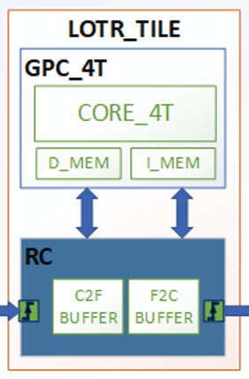
Introduction
Main Idea
General Purpose Compute Unit
RISC-V 32i Core with 4 hardware threads
Data & Instruction Memories
Integration Ability to RC – Ring Controller
With RC integration – a LOTR Tile – piece of the LOTR Project

Slide 4
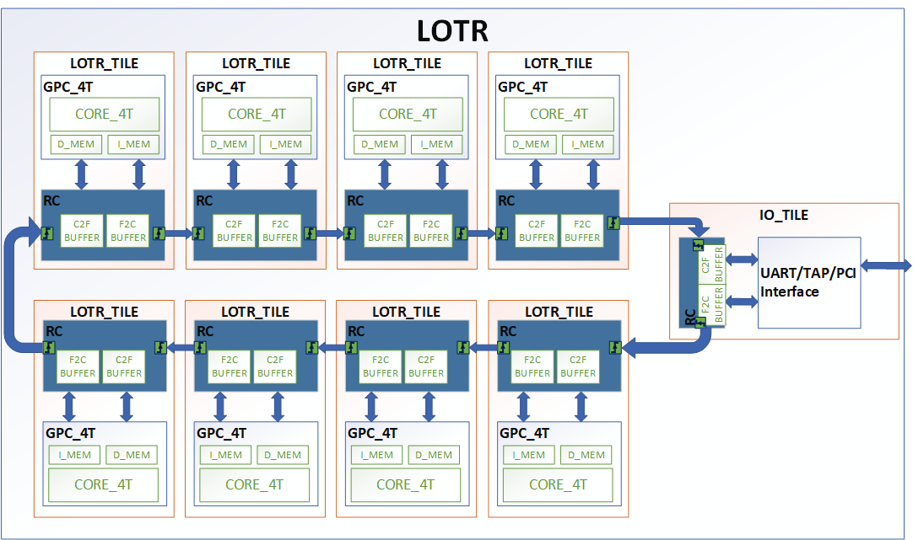

Introduction
LOTR Project
FABRIC
Ring Architecture

Slide 5
Introduction
Project’s Structure
HIGH-LEVEL-SPECIFICATIONS (HAS)
MICRO-ARCHITECTURE-SPECIFICATIONS (MAS)
VALIDATION PLAN
DEVELOPMENT ENVIRONMENT & METHODOLOGIES

Slide 6
HAS

Slide 7
HIGH-LEVEL-SPECIFICATIONS
3 Main building block
I MEM WRAP
D MEM WRAP
Core

Slide 8

HIGH-LEVEL-SPECIFICATIONS
2 Standard interfaces from RC
I MEM WRAP
D MEM WRAP
Ring
Core

Slide 9


RISC – V 32i
Compatible with the RISCV ISA - RV32I

Slide 10
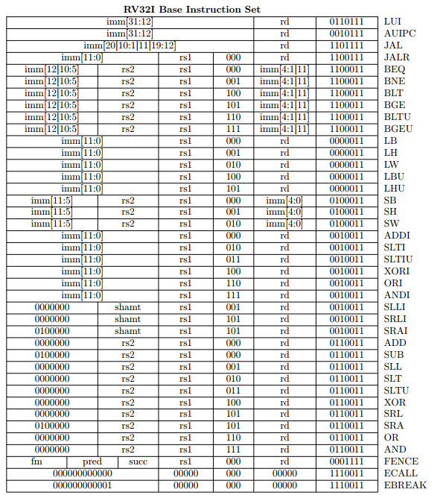
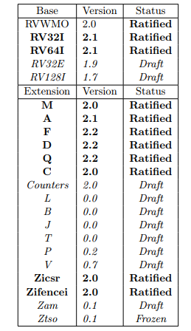
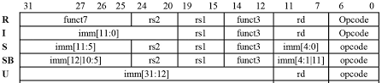
RISC – V 32i
an open-source base-integer instruction set architecture (ISA)
RISC V assembly commands encoded to 32-bit
5 types of 32 bits encoded commands
RISC V32i commands can be found here
RV32I support only integer based. Gpc_4T does not support RISC-V 32M which support multiplication command or RISC V-32F

Slide 11

Multithreading
Multithreading – Fine Grain Multithreading
Cyclic order. 1 thread per cycle – single scalar
©Image from Prof. Freddy Gabbay’s lectures on computer architectures

Slide 12
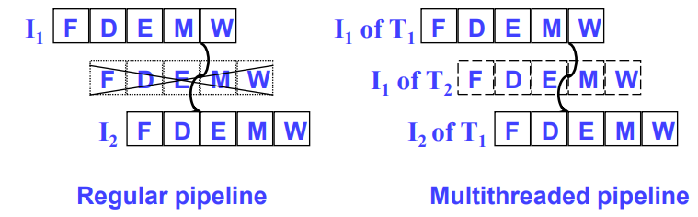
Multithreading
No Data hazards
Each thread has is own PC and registers
Each thread has its own stack base address in data memory
All threads share resources
©Image from Prof. Freddy Gabbay’s lectures on computer architectures

Slide 13
Pipeline
In – Order Pipeline with 5 stages:
Fetch
Decode
Execute
Memory
Write-Back
IPC = 1 IPC/Thread = 1/4
F
D
E
M
WB

Slide 14
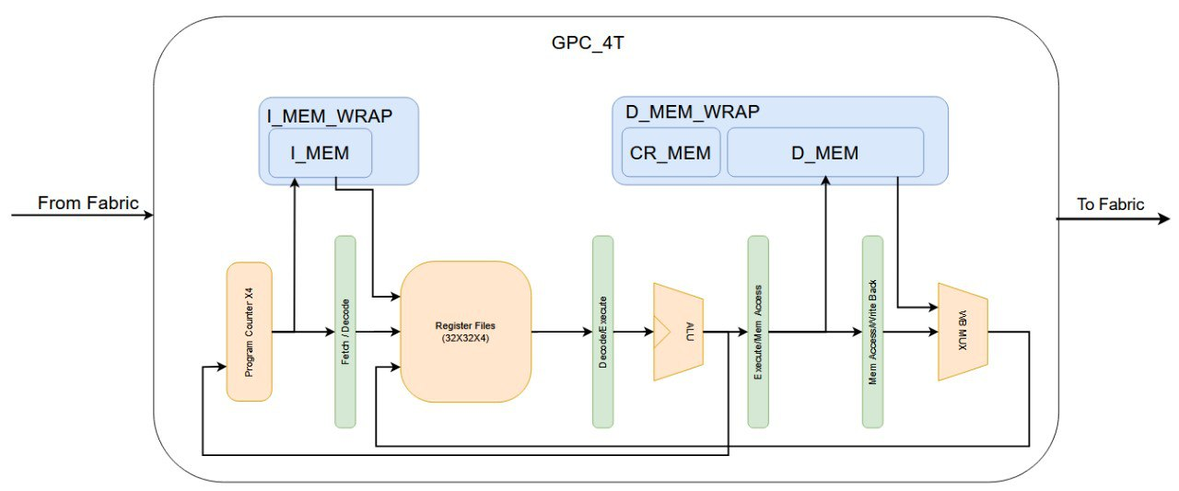
Building Blocks
Core
5 Pipe stages – Q100H, Q101H, Q102H, Q103H, Q104H,
Memory modules integrated

Slide 15
Memory Modules
Address space:
32 bits addressing
Offset – 12 bits – for data and instruction memory (4KB)
Region – 2 bits – request destination:
00 – I Mem
01 – D Mem
11 – CR Mem
Core Id – 8 bits – unique core id for each core in the LOTR fabric
Reserved – for future possible additions
Memory Offset | reserved | Region | Core ID
Address[11:0] | Address[21:12] | Address[23:22] | Address[31:24]

Slide 16

Memory Modules
Instruction Memory (I MEM) & Data Memory (DMEM)
4KB Sized Memory
S-RAM based
Dual port – input and output (core and RC)
S-RAM Instruction Memory
S-RAM Data Memory
Offset : 0x0000_0000
Encoded Region : 00
Offset : 0x0040_0000
Encoded Region : 01

Slide 17
Memory Modules
I MEM Wrap
Encapsulate the I MEM module
Has interface with the core and with the Ring controller
Ring
Core
I mem
R
W

Slide 18
Memory
Control registers Memory (CR MEM)
Unique memory region for special requests
Flip Flop based memory – all data saved in flops
Holds control read only data such as current running thread and core, each thread’s PC, etc.
Control writable flops with abilities such freeze and reset PC for each thread.
Core and Ring access

Slide 19
Memory Modules
D MEM Wrap
Encapsulate the D MEM and the CR MEM modules
Has interface with the core and with the Ring controller
Take care of Non-local memory transactions.
Ring
Core
D mem
R/W
R/W
Cr
Comb. Logic

Slide 20
Supported features
CR table & functionality
Offset | Name | Type | Structure
0 | WHO_AM_I | RO | [15:0]
4 | CR_THREAD_ID | RO | [1:0]
8 | CR_CORE_ID | RO | [7:0]
C | CR_STACK_BASE_OFFSET | RO | [15:0]
10 | CR_TLS_BASE_OFFSET | RO
14 | CR_SHARED_BASE_OFFSET | RO | [15:0]
18 | CR_I_MEM_MSB | RO | [7:0]
20 | CR_D_MEM_MSB | RO | [7:0]
24 | CR_THREAD<id>_STATUS | RO | [7:0]
110 114 118 11c | CR_THREAD<id>_EXCEPTION_CODE | RO | [31:0]
120 124 128 12c | CR_THREAD<id>_PC_RST | RW | [0]
130 134 138 13c | CR_THREAD<id>_PC_EN | RW | [0]
140 144 148 14c | CR_THREAD<id>_DFD_REG_ID | RW | [4:0]
150 154 158 15c | CR_THREAD<id>_PC | RO | [31:0]

Slide 21
Other Features
Non-local memory access via Ring Controller
Freeze/reset PC of a thread from software (thru CR mem)
Freeze/reset PC of a thread from hardware

Slide 22
MAS

Slide 23
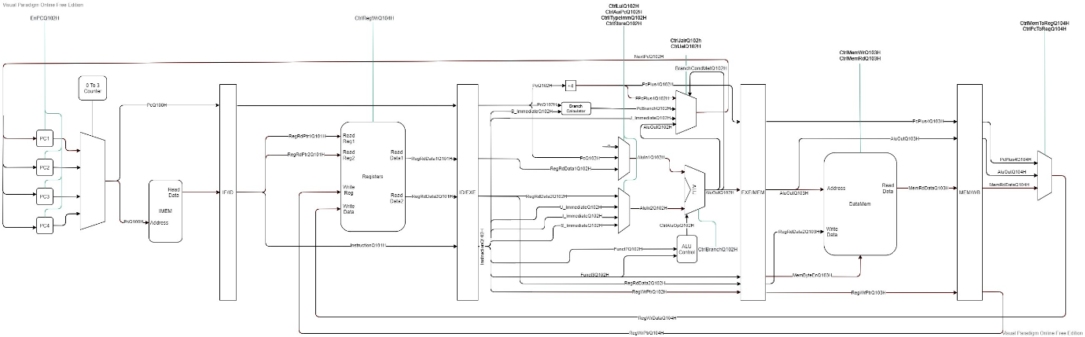
Micro-Level Architecture

Slide 24

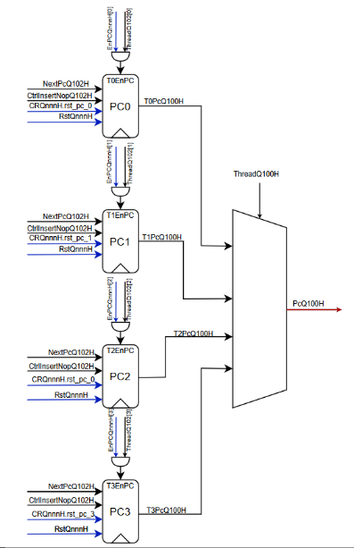
Micro-Level Architecture
Logic Design implementation of GPC_4T Architectonic demands
I need 4 separate PCs
HAS
MAS

Slide 25
Design Building Blocks
Main blocks:
Core_4t – RISC V Core
D_Mem – data memory
CR_Mem – control registers memory
D_MEM_WRAP – wrapper for d_mem + cr_mem
I_Mem – Instruction memory
I_Mem_Wrap – wrapper for i_mem
GPC_4T – integration for core+wrappers

Slide 26
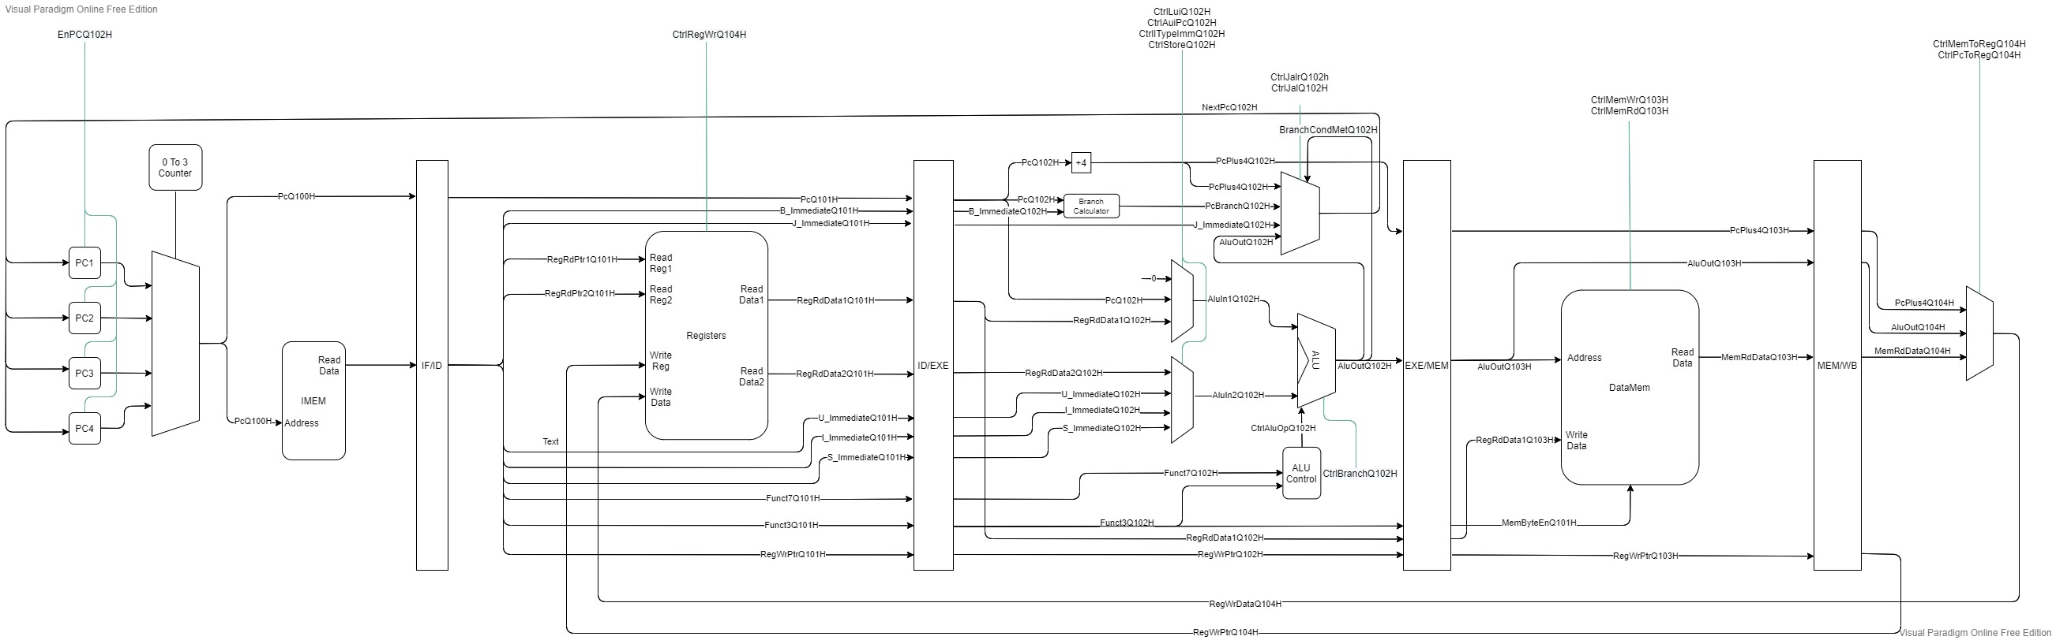
Core block diagram

Slide 27
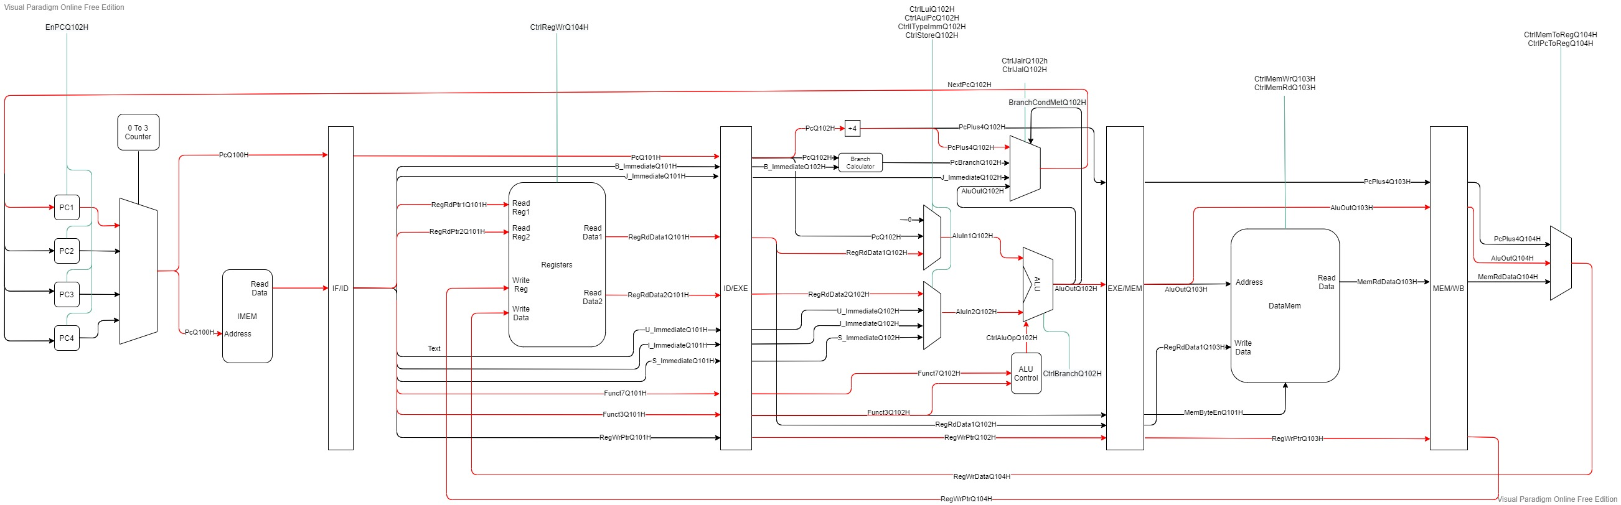
Core block diagram
ADD x1 x2 x1

Slide 28
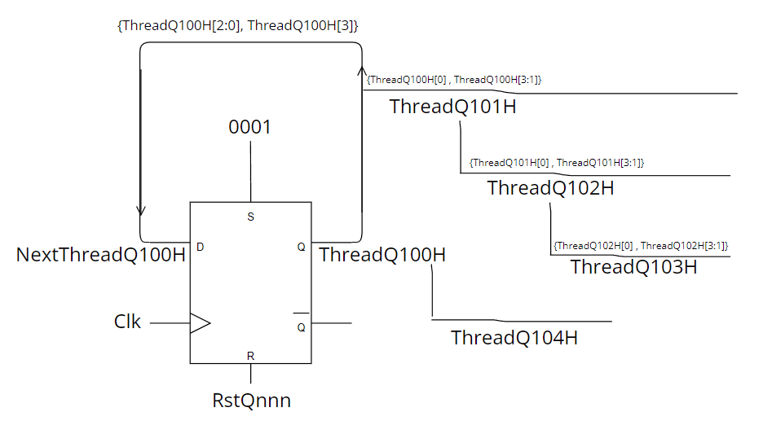
Core Design
Thread switch - Scheduler:
Cycle 0 :
ThreadQ100H = 0001
NextThreadQ100H = 0010
Cycle 1 :
ThreadQ100H = 0010
NextThreadQ100H = 0100
Cycle N :
ThreadQ100H = 1000
NextThreadQ100H = 0001
ThreadQ101H = 0100
ThreadQ102H = 0010
ThreadQ103H = 0001
ThreadQ104H = 1000

Slide 29
Core’s Pipe Stages
Fetch – Q100H
Maintain 4 Program counters
Next PC calculated on Q102H
Send PC to the I mem – request an instruction

Slide 30
Pipe stages : Q100H
Next PC determine on Q102H

Slide 31
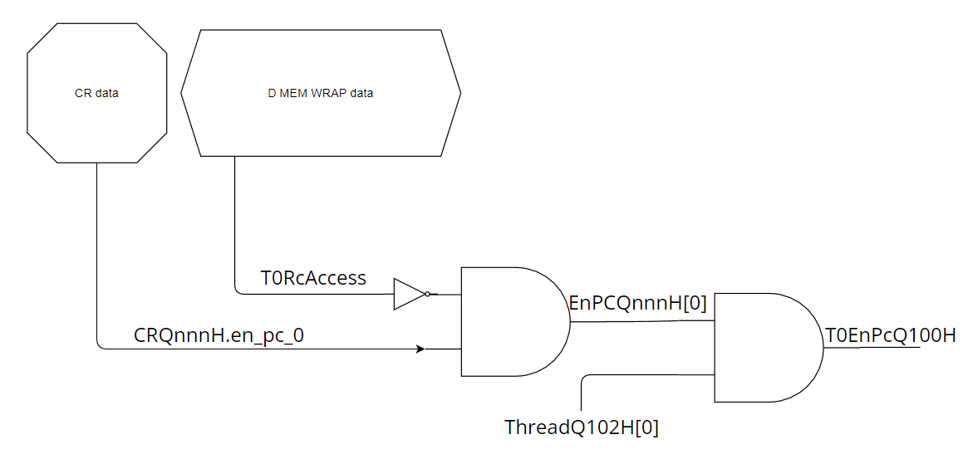
Pipe stages : Q100H
PC’s Shalter:
Multithread – Pc enabled when thread’s turn
Freeze PC thru software from CR
Freeze PC from hardware – exmaple: reading from non-local core

Slide 32
Pipe stages : Q100H
Nop is injected

Slide 33
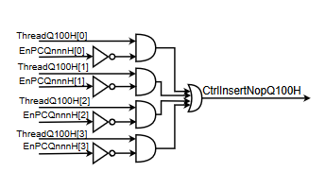
Pipe stages : Q100H
Insert Nop:
PC for thread 0 is disabled
Thread 0 is now at Q100H
Will bubble up the pipe until Q102H
insrtNopQ102H go to “En” PC0 flop

Slide 34
Pipe stages : Q100H
Nop is injected

Slide 35
Core’s Pipe Stages
Decode – Q101H
Receive 32-bit encoded instruction from i mem
Decode and extract relevant data from the instruction
Read relevant registers
Toggle the control signals

Slide 36
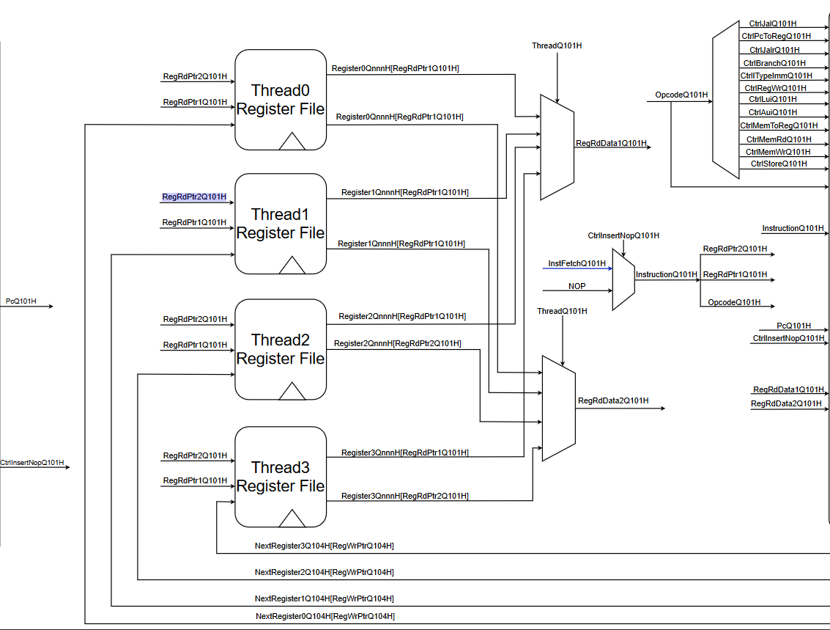
Pipe stages : Q101H
I Mem
Instruction from I MEM
Decode data from I

Slide 37
Pipe stages : Q101H
Registers numbers from decoded instruction

Slide 38
Pipe stages : Q101H
Registers numbers from decoded instruction

Slide 39
Pipe stages : Q101H

Slide 40
Core’s Pipe Stages
Execute – Q102H
Arithmetic calculations with ALU
Next PC determination
Brach comparator

Slide 41
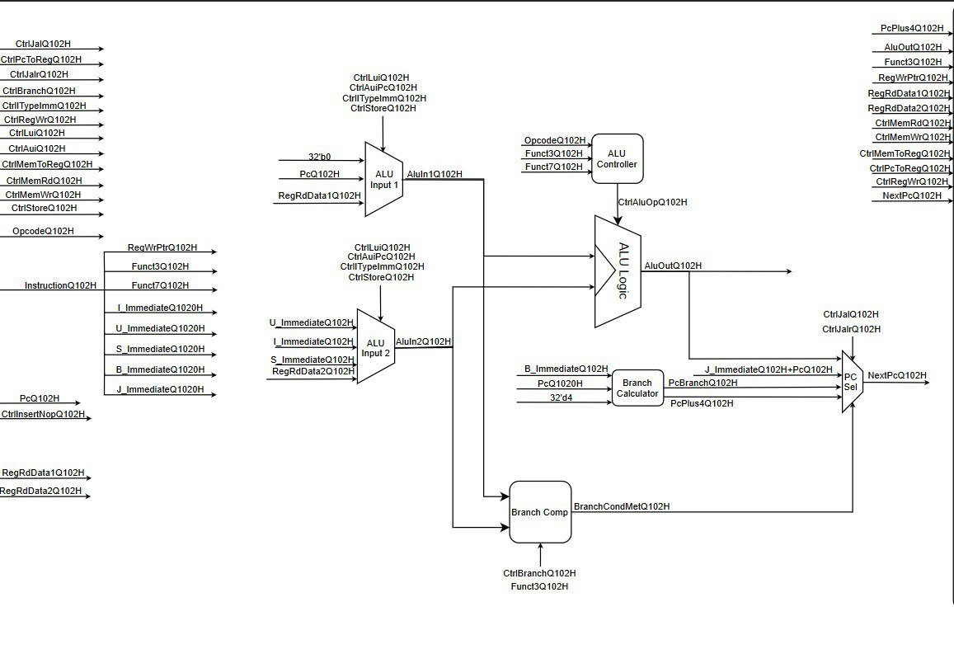
Pipe stages : Q102H

Slide 42
Core’s Pipe Stages
Memory – Q103H
Data memory (D mem) transaction
Data is read or written to the d mem

Slide 43
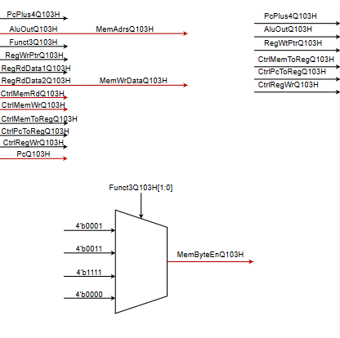
Pipe stages : Q103H
Data Memory
Not much happened on the core
MemRdDataQ103

Slide 44
Core’s Pipe Stages
Write Back – Q104H
Determine written data source – ALU, Memory, PC
Writes data in the registers

Slide 45
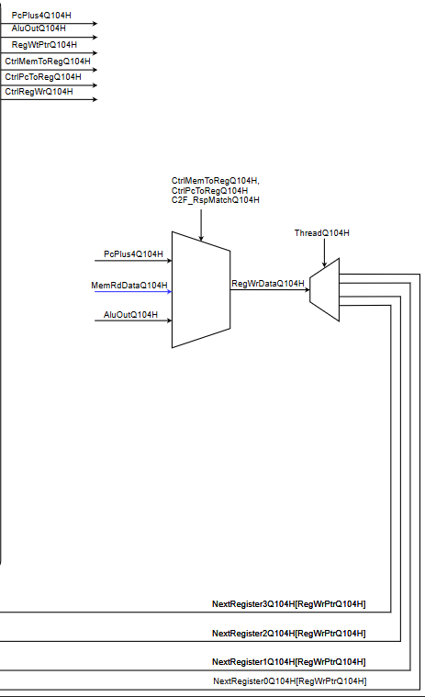
Pipe stages : Q104H

Slide 46
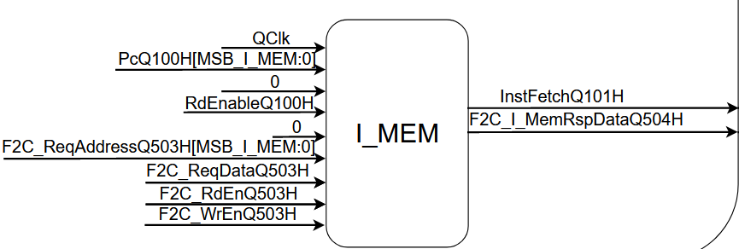
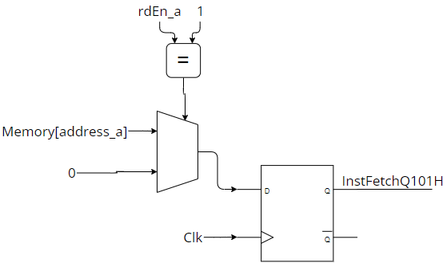
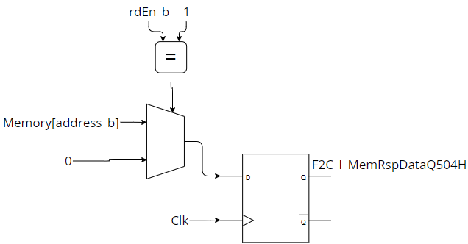
I Mem Design
Behavioral Memory - mem[SIZE_I_MEM-1:0];
Dual Port
2 Output flops
PC
F2C address
ReadEN
WriteEn
Write Data
Core
RC
Instruction Fetch
F2C data

Slide 47
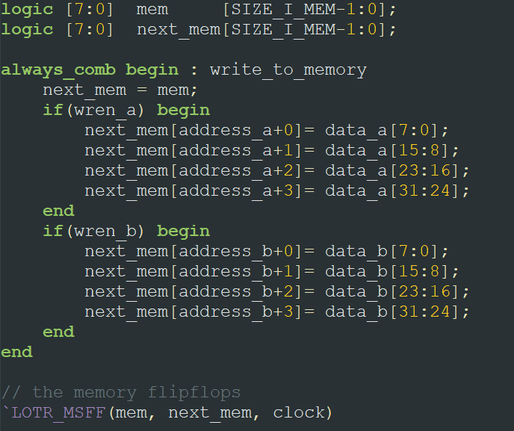
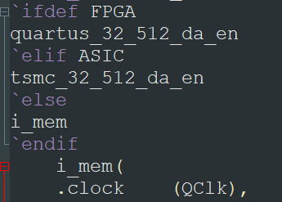
I Mem Design

Slide 48
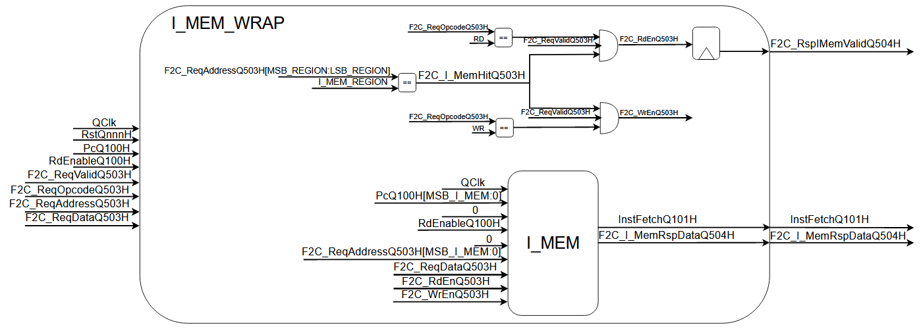
I Mem Wrap Design
I MEM instance
Core interface
Ring interface

Slide 49
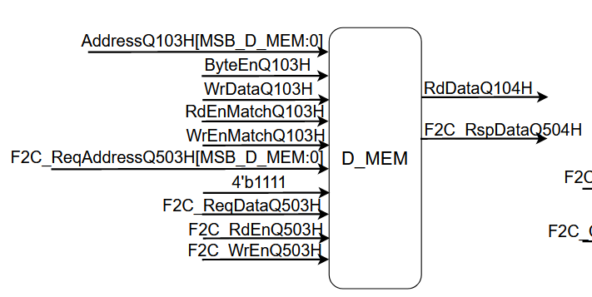
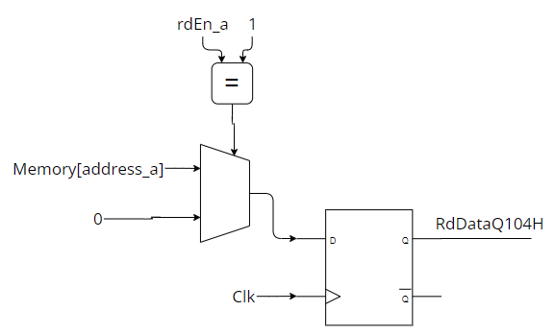
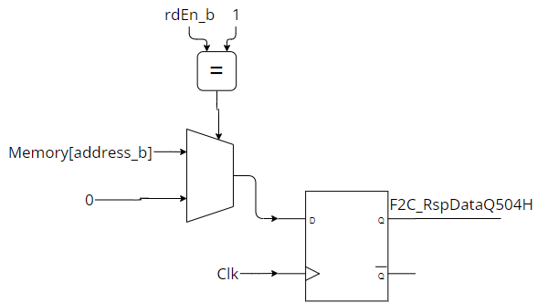
D Mem Design
Behavioral Memory - mem[SIZE_D_MEM-1:0];
Dual Port
Core
RC
Address
F2C Address
ReadEN
ReadEN
WriteEN
WriteEN
Write Data
Write Data
ByteEN
ByteEN
Read Data
F2C Read Data

Slide 50
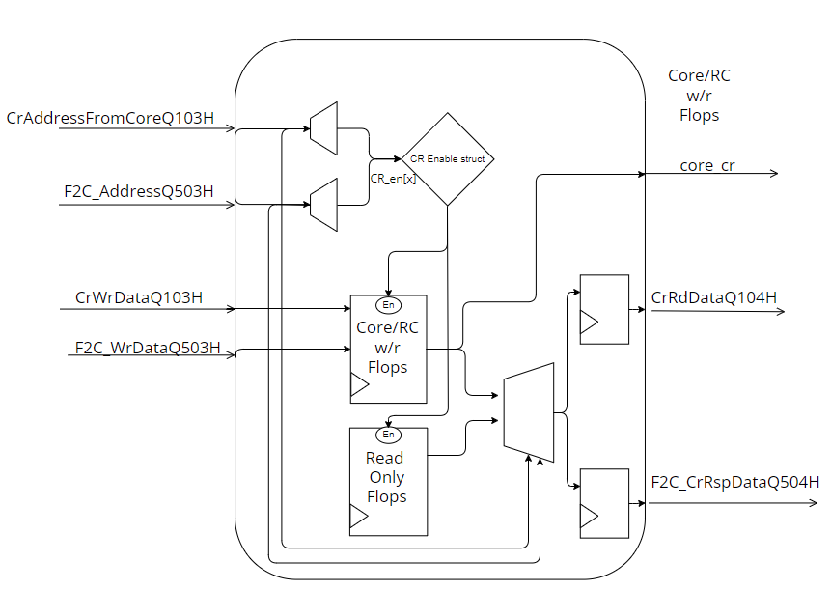
CR Mem Design
Big number of flops
Get data from hardware

Slide 51
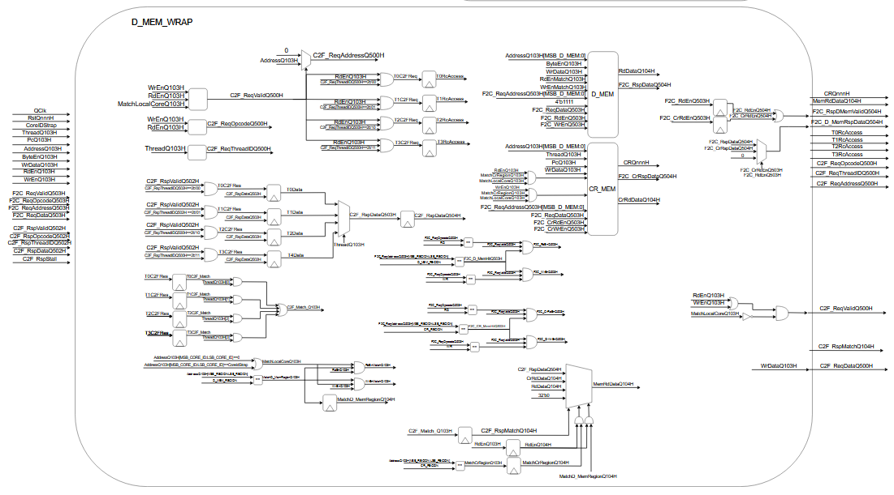
D Mem Wrap Design

Slide 52
D Mem Wrap Design

Slide 53

Supported features
Non-local memory access:
Read:
Read request with core ID(bits 31:24) $≠$ local core, will be directed by the D mem wrap to Ring Controller
Requested thread’s PC will be frozen (“Nop injection”) until response arrives from RC
Date read will written to registers in the Q104H stage
Write:
write request with core ID(bits 31:24) $≠$ local core, will be directed to Ring Controller
No waiting for response – shoot and forget
RC will pass the request to designated core’s memory

Slide 54
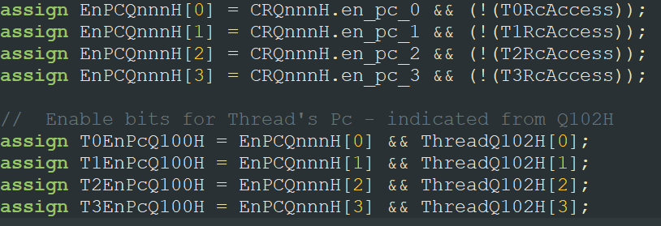
Design Flows
Thread Freeze using CRs:
Thread can freeze other thread’s PC
Write `0 to CR space with offset:
Each PC flop Enable is fed from CR data
Offset | Name | Type | Structure
150 | THREAD<i>_PC_EN | RW | [0]
154
158
15c

Slide 55
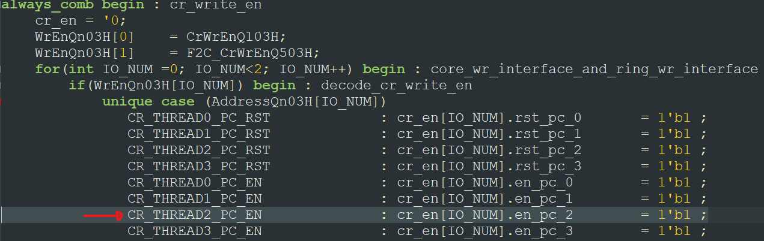
Thread Freeze using CRs:
Thread0 freeze Thread2 PC:
Write `0 to (0x00C00158).
MatchCrRegion signal invoked
On CR_MEM decode and write:
Offset | Name | Type | Structure
150 | THREAD<i>_PC_EN | RW | [0]
154
158
15c

Slide 56
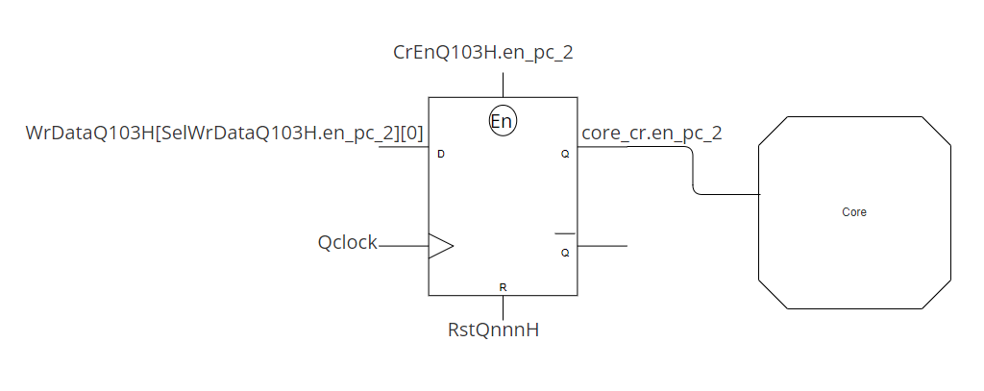
Thread Freeze using CRs:
Thread0 freeze Thread2 PC:
The `1 written is the enable bit for the En_PC2 flop
Thread0 written `0 will sampled by this flop
`0 will go to Core and disable the PC for thread 2

Slide 57
Validation Plan

Slide 58

Intro
How can we make sure are design will work as expected ?

Slide 59

Intro
Validation !
Test bench to simulate GPC_4T
RISC V GCC to compile test C programs
Backdoor load file to the I mem (and Heap Mem)
Logs to track and verify behavior
Automation to make life easy

Slide 60
GCC RISCV Compiler
GCC to generate test flow
Write c program dedicate to test a certain aspect in GPC_4T
Use RISC V WSL Toolchain to generate RISC V assembly file from C file
Use the Toolchain to generate 32 bits instruction sv file

Slide 61

RISC V GNU Compiler Toolchain
Toolchain
Bundle of software tools cloned from "riscv-gnu-toolchain" Git repositories
Use GCC based compiler

Slide 62
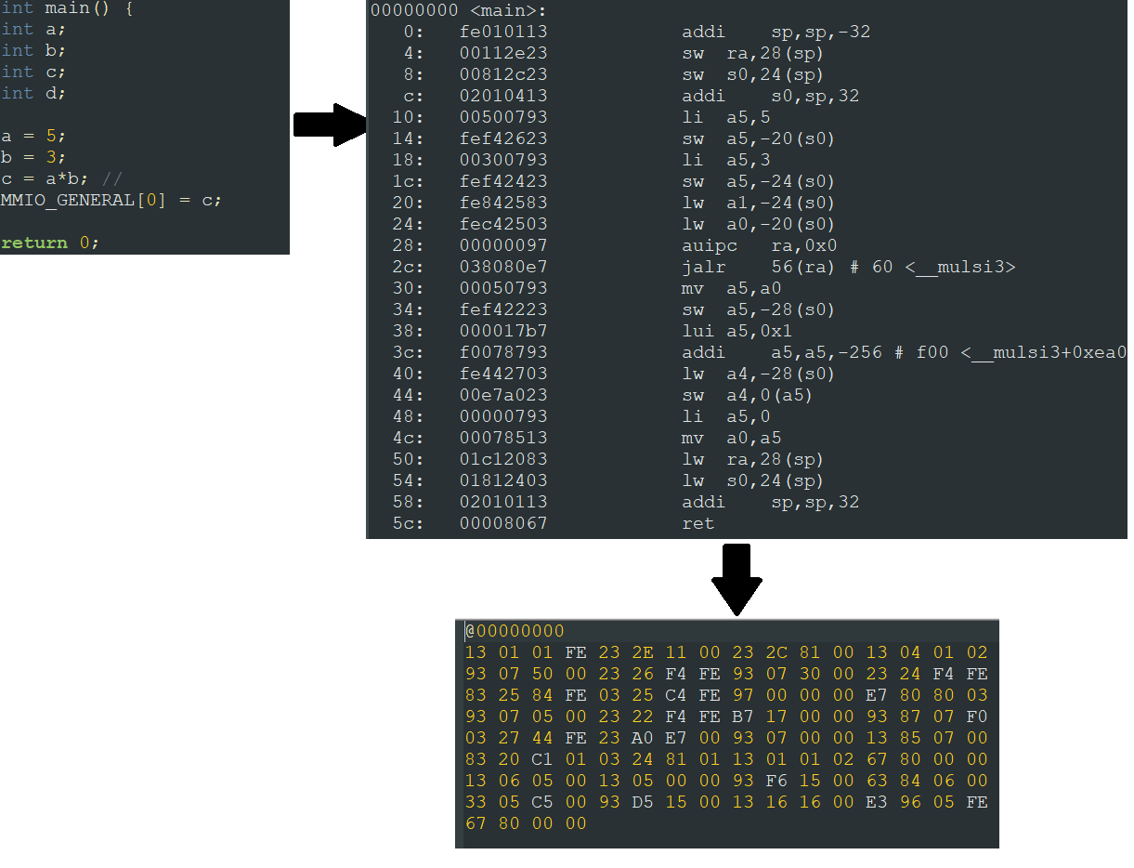
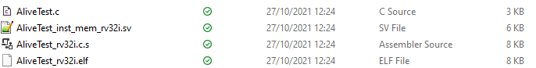
RISC V GNU Compiler Toolchain
Toolchain
C program
> RISC V assembly
> binary sv file
> elf file
Used by the Testbench as the instruction memory

Slide 63
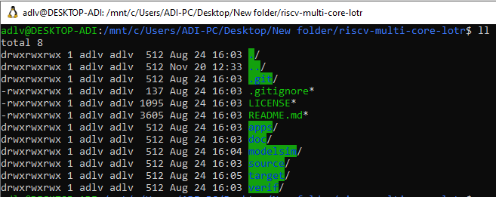
RISC V GNU Compiler Toolchain
WSL environment
Windows Subsystem Linux
We used Ubuntu
There are alternative – windows-based compilers

Slide 64
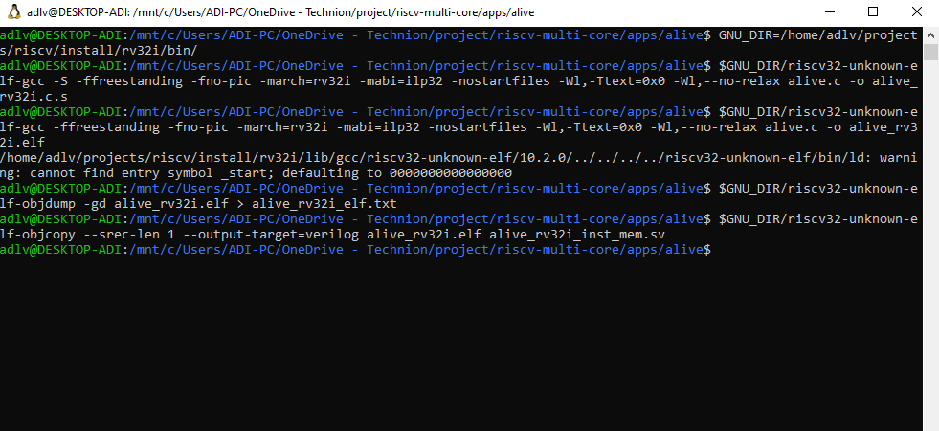
RISC V GNU Compiler Toolchain
Compiling commands

Slide 65
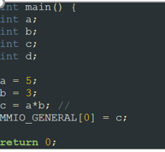
GCC RISCV Compiler

Slide 66
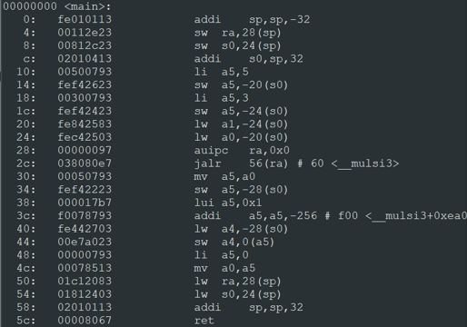
GCC RISCV Compiler

Slide 67
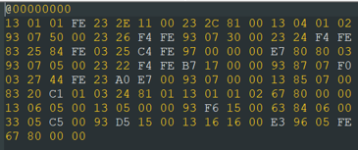
GCC RISCV Compiler

Slide 68
GCC RISCV Compiler
Alive Test
Debug a program can be very complex
Alive Test is easy to debug
Simple RISC V commands
Runs and compare with expected results

Slide 69
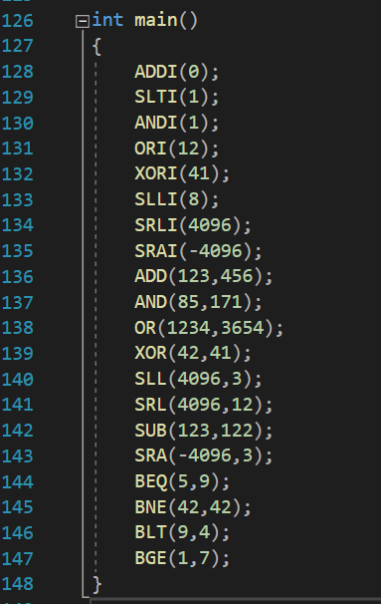
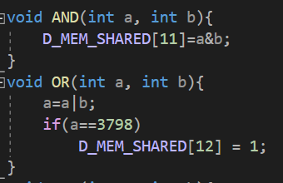
GCC RISCV Compiler
Alive Test
Simple commands
Easy expected results

Slide 70
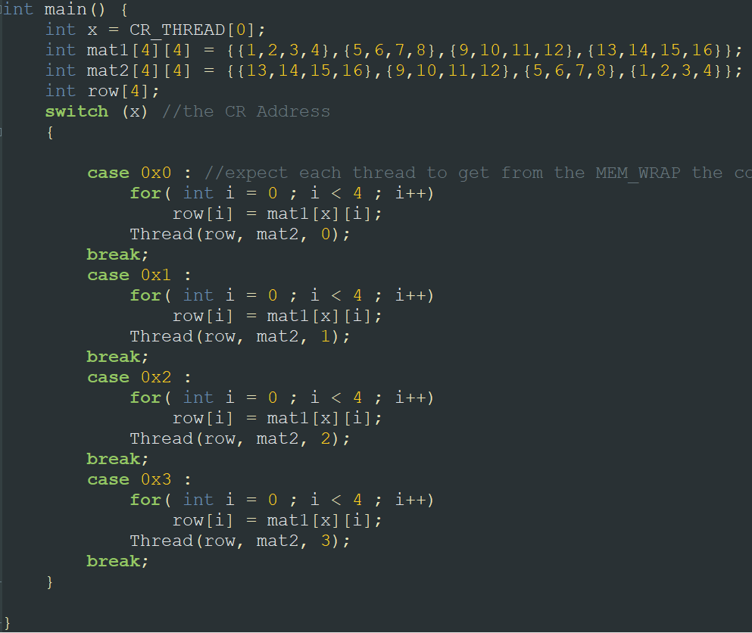
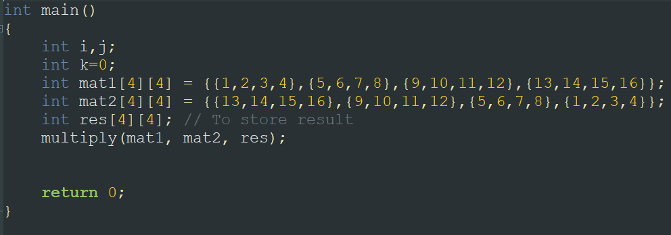
GCC RISCV Compiler
Multithread test – Matrix Multiplication
4x4 matrix multiply
Single thread code vs. parallel Multithread code
vs.

Slide 71
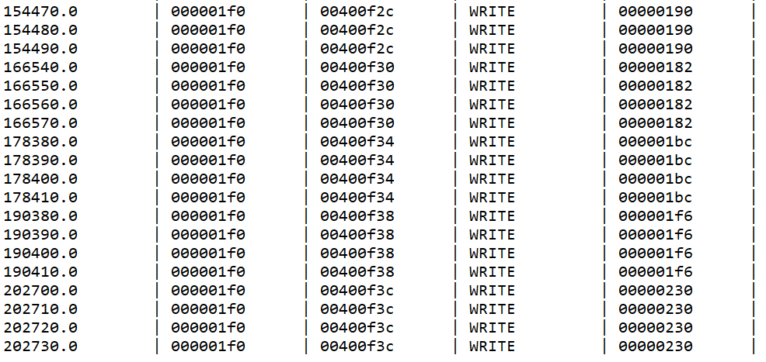
GCC RISCV Compiler
Single thread

Slide 72
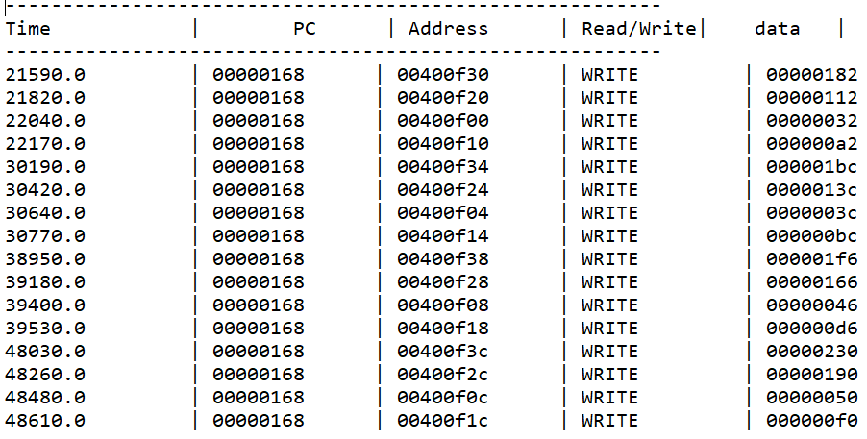
GCC RISCV Compiler
Multithread:

Slide 73
GCC RISCV Compiler
Winner:
Multithread

Slide 74
System Verilog Test Bench
Gpc4t_tb.sv
Used for simulating the design (with ModelSim)
Instantiates the gpc_4t module
Generates clock and reset signals
Uses backdoor to inject instructions .sv file to i mem module
If necessary, use backdoor for heap data memory
Timeout for simulation defined there

Slide 75
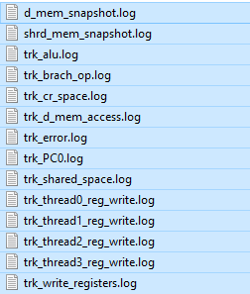
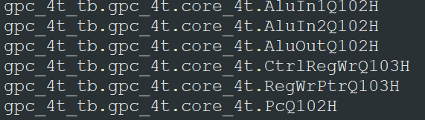
System Verilog Test Bench
Log generator
Initiate by the test bench
Sniff signals values and memory data from gpc_4t instantiated module using XMR
Use file system to create log files with the sampled data
Logs were our most important debug tool

Slide 76
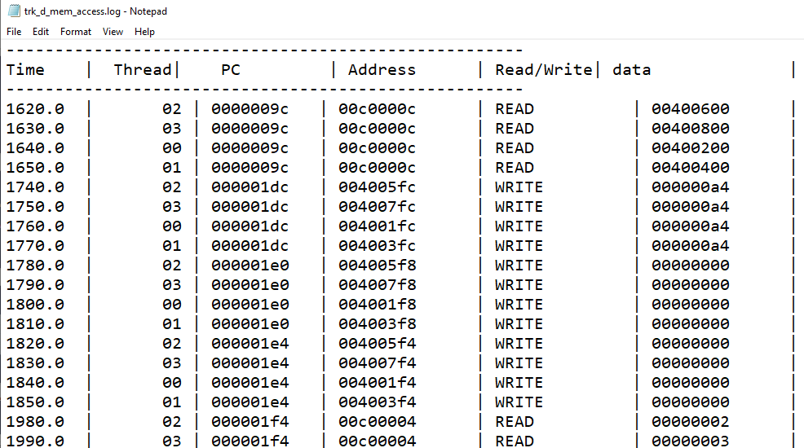
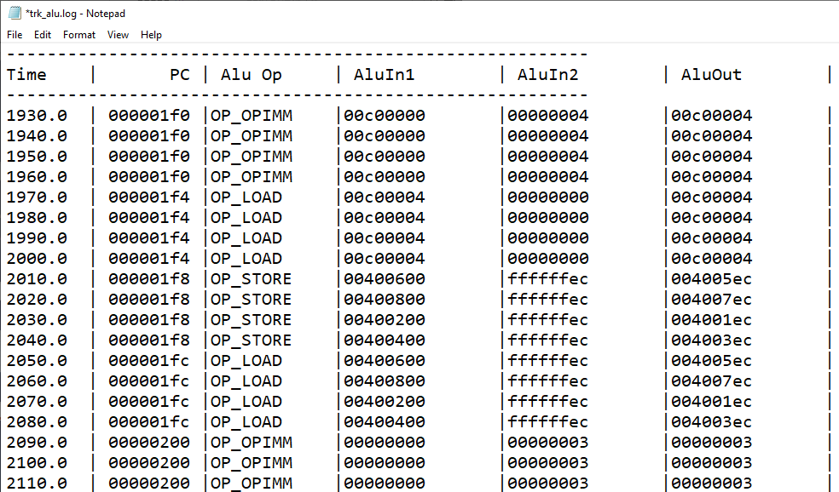
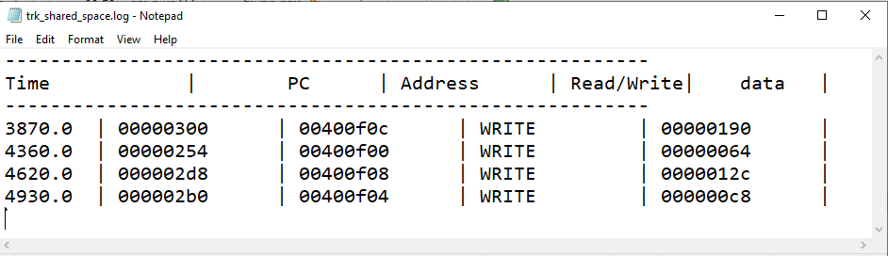
System Verilog Test Bench
Log examples:

Slide 77

System Verilog Test Bench
End of Test Checker
At end of simulation, we compare generated memory snapshot to “golden memory snapshot”
“golden” is how we expect memory to be
If both are identical – test passed!
Else – time for debug….

Slide 78
System Verilog Test Bench
Assertions
used to "catch" unwanted behavior and violations of the GPC_4T
implemented in the log generator
On some occasions – terminates the simulation

Slide 79

System Verilog Test Bench
Assertions

Slide 80
System Verilog Test Bench
RTL compilation
Prior to simulation, made by ModelSim
Compiles the test bench and all of the design Verilog files – Gpc_4t, Core, Memories, etc.
Can be performed with ModelSim GUI or with Windows PowerShell.

Slide 81

System Verilog Test Bench
List.f

Slide 82

System Verilog Test Bench
Simulation

Slide 83


System Verilog Test Bench
Performed by ModelSim
GUI waveform, Log files
ADD x1(=4) x2(=5)

Slide 84
Development & Methodologies

Slide 85

Git & GitHub
Git
Software to track changes on shared files
GitHub
Internet hosting service provide git support
Maintain LOTR repository

Slide 86

Git & GitHub
LOTR Repository

Slide 87

Git & GitHub
Task Management

Slide 88

Git & GitHub
Discussions

Slide 89

Git & GitHub
Wikia

Slide 90
RISC V GNU Compiler Toolchain
Toolchain
Discussed before

Slide 91

System Verilog
Hardware Description Language
GPC_4T RTL (GPC_4T, Core, Memories)
GPC_4T test bench
GPC_4T defines and MACROs
FPGA synthesizable

Slide 92


System Verilog
Coding Style
MACROs for flip-flops

Slide 93


ModelSim
Environment for simulation HDL
elaboration, compilation, simulation
GUI, Waveform debug
PowerShell

Slide 94

PowerShell & Bash
Automation scripts
Bash for scripting with Toolchain commands
PowerShell for scripting ModelSim commands
Enhance workflow

Slide 95


PowerShell & Bash
Gpc_compile_link.sh
BASH language script
Initiate all Toolchain commands on C program
Creates folder for all test files(C, asm, sv, elf, etc)
Creates heap memory file if necessary by the program

Slide 96
Future Plans
Project B - Implementation of an LOTR RISC-V Based System on Chip (SOC) on an FPGA
Architecture Optimize
New development environments (Windows)
RISC-V official
FPGA
More tests
More features

Slide 97
Future Plans
HW integration
Design and test on front door access
Enable non local memory access
Debug and clean SoC model from all core and RC bugs
Add new trackers on RC IO
Design IO tile and integrate into standard quartus IO interface
Compile& synthesize design on quartus env
SW stack from host side (from PC host to FPGA)
LOTR Project

Slide 98
Future Plans
Project B - Implementation of an LOTR RISC-V Based System on Chip (SOC) on an FPGA
Optimize arch of pipe
Support prevlidged CSR RISC V exten’ to allow OS
Use windows based Toolchain GCC (not WSL)
Move all WSL\PS scripts to simple bash script
Enable official riscv “competabillity test”
Test the design on FPGA:
Syntisizable and timing convertion
Enable more complex mt tests
Support exception and error detections and inrretupts

Slide 99
The End

Slide 100

Question?

